Slide 1
Collaborative Filtering
Recommendar Engines

Slide 2
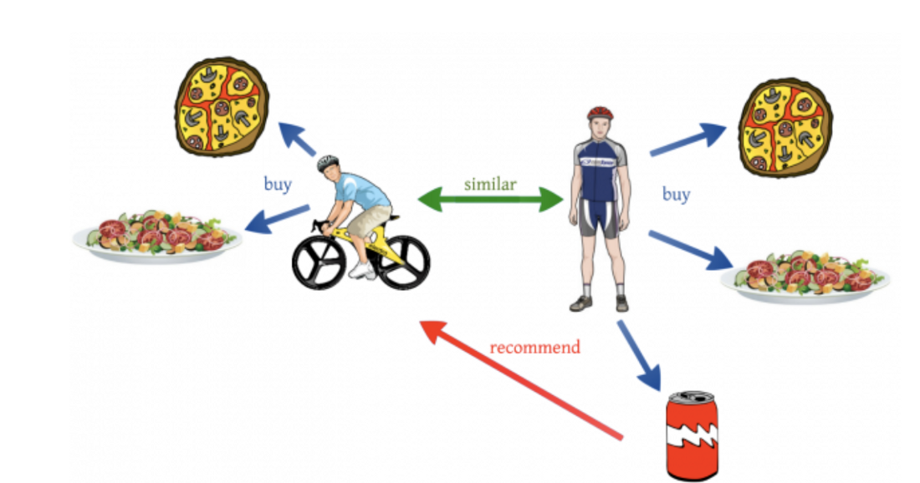

Slide 3
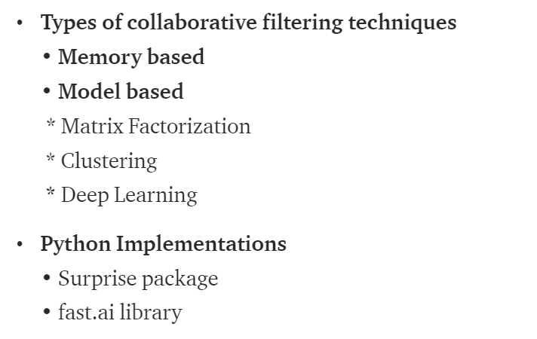

Slide 4
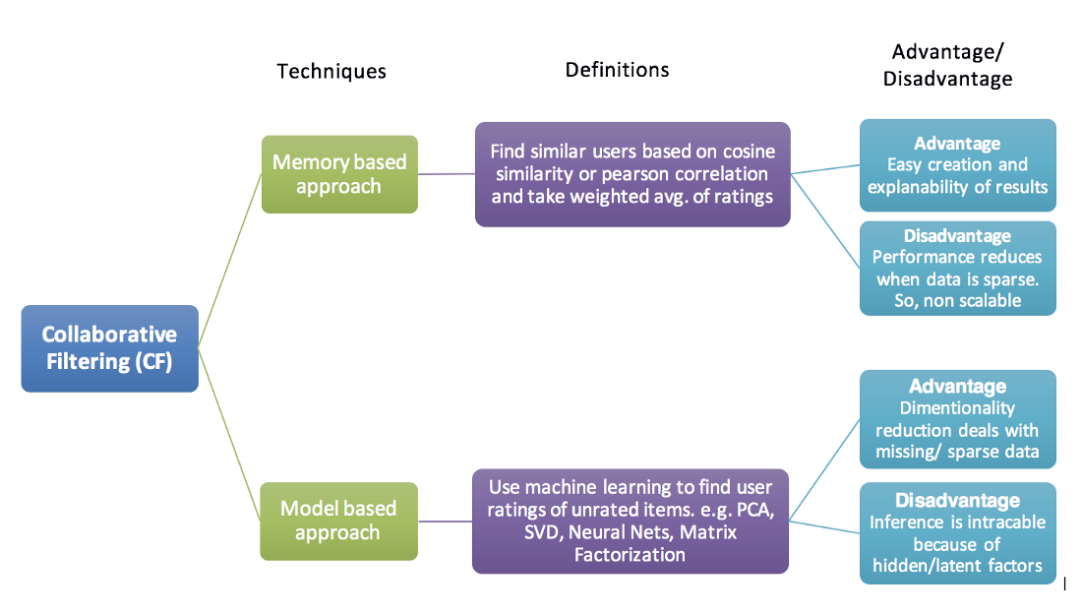

Slide 5
Memory-Based Collaborative Filtering approaches can be divided into two main sections: user-item filtering and item-item filtering.
A user-item filtering takes a particular user, find users that are similar to that user based on similarity of ratings, and recommend items that those similar users liked.
In contrast, item-item filtering will take an item, find users who liked that item, and find other items that those users or similar users also liked. It takes items and outputs other items as recommendations.

Slide 6
The closest user or items are calculated only by using Cosine similarity or Pearson correlation coefficients, which are only based on arithmetic operations.

Slide 7
non parametric ML approaches like KNN (clustering) should also come under Memory based approach
As no training or optimization is involved, it is an easy to use approach. But its performance decreases when we have sparse data which hinders scalability of this approach for most of the real-world problems.

Slide 8
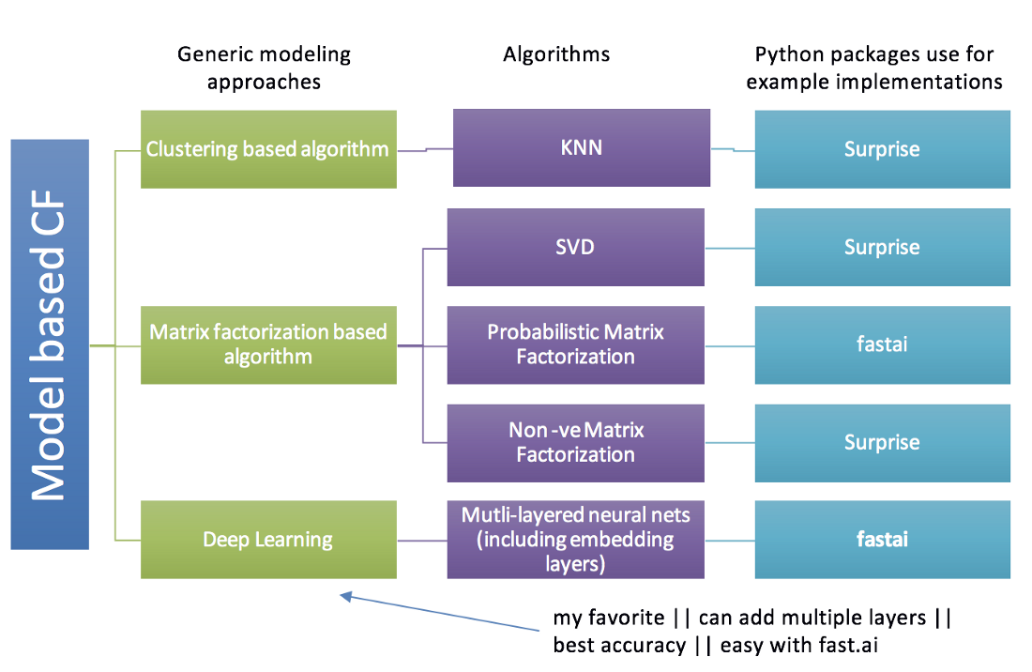

Slide 9
Fast.ai

Slide 10
pip install scikit-surprise
Anaconda
conda install -c conda-forge scikit-surprise

Slide 11
Case 1: Recommend the most popular items
Case 2: Using a classifier to make recommendation
Case 3: Recommendation Algorithms (CF)

Slide 12
Content-Based Filtering
In content-based filtering, the similarity between different products is calculated on the basis of the attributes of the products. For instance, in a content-based movie recommender system, the similarity between the movies is calculated on the basis of genres, the actors in the movie, the director of the movie, etc.
Collaborative Filtering
Collaborative filtering leverages the power of the crowd. The intuition behind collaborative filtering is that if a user A likes products X and Y, and if another user B likes product X, there is a fair bit of chance that he will like the product Y as well.

